Slide 1

By:
Alex Morsey
Bryce Baker
Gregg McMillion

Slide 2

We created the Pokemon Menu Displaying:
Pokedex
Pokemon Party
Items
Badges

Slide 3
Each menu option using various techniques we’ve learned in Data Structures such as:
Binary Trees
Queues
Bubble Sort
Selection Sort
Stacks
Hashings

Slide 4
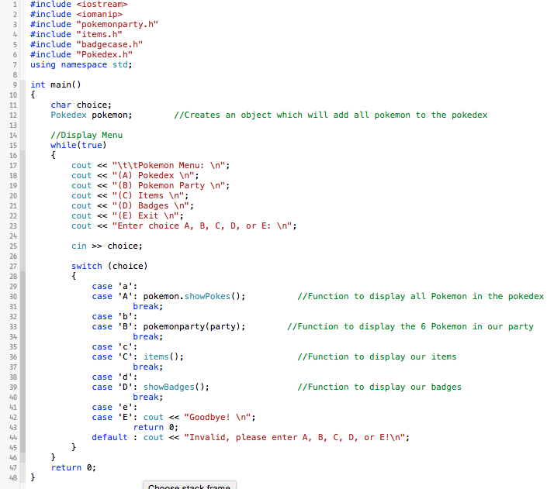
Main.cpp
Uses switch cases to navigate the menu
Each case calls a different function which are located in separate header files.

Slide 5
Case A.

Slide 6
Case B

Slide 7
Case C

Slide 8
Case D

